Slide 1
Lecture 5 Factor Analysis
Faculty of Computer Science
Data Analysis
Moscow 2022
Lecturer: Alisa Melikyan, amelikyan@hse.ru, PhD,
Associate Professor of the School of Software Engineering

Slide 2
Factor Analysis
Data Analysis
Lecture 5
Factor Analysis
Factor analysis is a data reduction technique used to reduce a large number of variables to a smaller set of underlying factors that summarize the essential information contained in the variables. More frequently, factor analysis is used as an exploratory technique when the researcher wishes to summarize the structure of a set of variables.

Slide 3
Types of factor analysis
Data Analysis
Lecture 5
Factor Analysis
There are two basic forms of factor analysis, exploratory and confirmatory.
In confirmatory factor analysis we want to test specific hypothesis about the structure or the number of dimensions underlying a set of variables. Factor analysis will confirm or not the existence of the latent variables.
Exploratory factor analysis is undertaken when we do not have a pre-defined idea of the structure or how many dimensions are in a set of variables. It’s an investigatory process that helps researchers understand whether associations exist between the initial variables, and if so, where they lie and how they are grouped.

Slide 4
Uses of factor analysis
Data Analysis
Lecture 5
Factor Analysis
1) To understand the structure of a set of variables (e.g. pioneers of intelligence such as Spearman and Thurstone used factor analysis to try to understand the structure of the latent variable “intelligence”);
2) To reduce a data set to a more manageable size while retaining as much of the original information as possible (e.g. multicollinearity can be a problem in multiple regression; factor analysis can be used to solve this problem by combining variables that are collinear).

Slide 5
Steps of the factor analysis
Data Analysis
Lecture 5
Factor Analysis
Computation of the correlation matrix – to determine the appropriateness of the factor analytic model;
Factor extraction – to determine the number of factors necessary to represent the data;
Rotation – to make the factor structure more interpretable.
Understanding the semantic essence of factors.

Slide 6
Assumptions
Data Analysis
Lecture 5
Factor Analysis
There are a number of assumptions and practical considerations underlying the application of the factor analysis:
Sample size – a minimum of five subjects per variable is required for factor analysis. A sample of 100 subjects is acceptable, but sample sizes of 200+ are preferable.
Linearity – because factor analysis is based on correlation, linearity is important. If linearity is not present, the solution may be degraded.
Outliers among cases – factor analysis is sensitive to outlying cases. These cases need to be identified and analyzed attentively.
Factorability of the correlation matrix – a correlation matrix that is appropriate for factor analysis will have several sizeable correlations.

Slide 7
Correlation matrix
Data Analysis
Lecture 5
Factor Analysis
R-matrix (or correlation matrix) represents the correlation between each pair of selected variables. The existence of clusters of large correlation coefficients between subsets of variables suggests that those variables could be measuring aspects of the same underlying dimension. These underlying dimensions are known as factors (or latent variables).
By reducing a data set from a group of interrelated variables into a smaller set of factors, factor analysis achieves parsimony by explaining the maximum amount of common variance in a correlation matrix using the smaller number of explanatory concepts.

Slide 8
Principal component analysis (PCA)
Data Analysis
Lecture 5
Factor Analysis
PCA is a dimensionality-reduction technique that is primarily used to represent high-dimensional data sets in fewer dimensions while preserving as much information as possible.
PCA, is a way to create an index from a group of variables that are similar in the information that they provide. This allows maximizing the information we keep, without using variables that will cause multicolinearity, and without having to choose one variables among many.
The method discovers hidden patterns and structures in the data without reference to any prior knowledge. The goal here is to find a limited number of principal components that best describe the data.

Slide 9
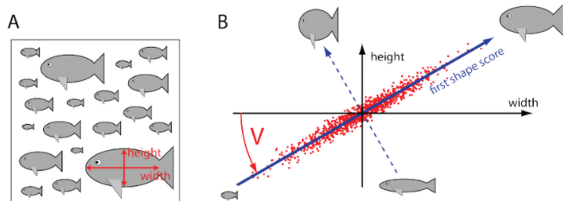
Principal component analysis
Data Analysis
Lecture 5
Factor Analysis
http://setosa.io/ev/principal-component-analysis/

Slide 10
Principal components
Data Analysis
Lecture 5
Factor Analysis
Principal components (PCs) are determined in order of retaining the variation present in the original data. The first PC is chosen to account for the maximum variation. The second and subsequent PCs are chosen in a similar way to account for the remaining variance unexplained by the previous PCs. Each PC must be independent of all the previous ones. This independence or lack of correlation is referred to as orthogonality.

Slide 11
Principal component analysis: main steps
Data Analysis
Lecture 5
Factor Analysis
1. Standardization of variables’ values (z-standardization).
2. Calculation of the covariance matrix.
3. Calculation of eigenvectors and eigenvalues of the covariance matrix to identify principal components.
4. Determining the number of main components (eigenvalues greater than 1).
5. Calculation of the principal components based on the values of the initial variables.

Slide 12
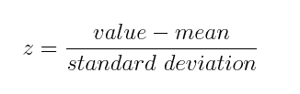
Principal component analysis: main steps
Data Analysis
Lecture 5
Factor Analysis
1. Standardization of variables’ values (z-standardization).

Slide 13
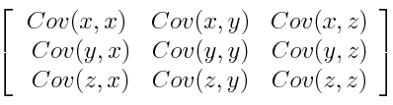

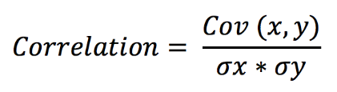
Principal component analysis: main steps
Data Analysis
Lecture 5
Factor Analysis
2. Calculation of the covariance matrix.

Slide 14
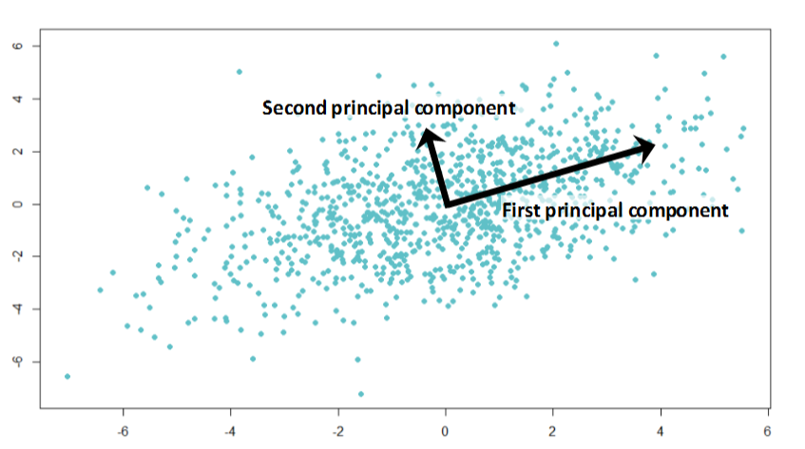
Principal component analysis: main steps
Data Analysis
Lecture 5
Factor Analysis
3. Calculation of eigenvectors and eigenvalues of the covariance matrix to identify principal components. Eigenvalues represent the variance of the original data contained in each principal component.
We choose a line to minimize the squared deviations of the points from the line.

Slide 15
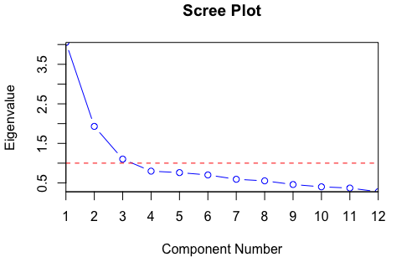
Principal component analysis: main steps
Data Analysis
Lecture 5
Factor Analysis
4. Determining the number of main components (eigenvalues greater than 1).

Slide 16
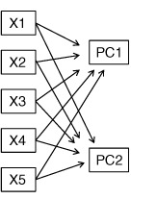
Principal component analysis: main steps
Data Analysis
Lecture 5
Factor Analysis
5. Calculation of the principal components based on the values of the initial variables. All initial variables are involved in the calculation of the values of the new principal components, but with different coefficients. In fact, the principal components are a linear combination of the values of the original variables.
PC₁ = a₁X₁ + a₂X₂ + ... + a_{k}X_{k}
PC₂ = b₁X₁ + b₂X₂ + ... + b_{k}X_{k}

Slide 17
Principal components’ properties
Data Analysis
Lecture 5
Factor Analysis
We receive as many principal components as there are initial explanatory variables.
Each principal component is expressed as a linear combination of the original variables.
The total variance of all input variables is equal to the total variance of all principal components. The principal components are selected so that the variance of each principal component at each step is as large as possible, so often the variance of the first principal component absorbs a significant part of the total variance of all initial variables. That is, the first several principal components can absorb a large share of the total variance of the original variables.

Slide 18
Example
Data Analysis
Lecture 5
Factor Analysis
Characteristics of an apartment:
total area
number of bus stops within walking distance
number of living rooms
number of schools within walking distance
number of balconies
number of grocery stores within walking distance
What factors could be extracted?

Slide 19
Example
Data Analysis
Lecture 5
Factor Analysis
Characteristics of a restaurant:
taste of food
food temperature
waiting time
cleanliness
freshness of food
staff behavior
What factors could be extracted?

Slide 20
Example
Data Analysis
Lecture 5
Factor Analysis
We want to measure different aspects of what might make a person popular. We will measure several aspects of person’s popularity:
1) Social Skills;
2) Selfishness;
3) Interest (how interesting others find them);
4) Talk 1 (the proportion of time they spend talking about the other person during a conversation);
5) Talk 2 (the proportion of time they spend talking about themselves);
6) Liar (propensity to lie to people).

Slide 21
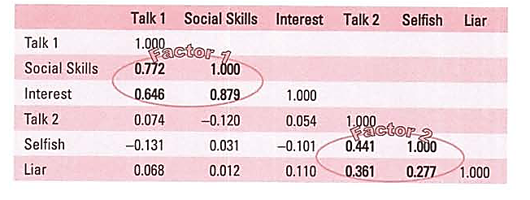
Example: correlation matrix
Data Analysis
Lecture 5
Factor Analysis
There are two clusters of interrelating variables. Therefore, these variables might be measuring some common underlying dimensions.
Factor 1: the better your social skills the more interesting and talkative you are likely to be.
Factor 2: selfish people are likely to lie and talk about themselves.

Slide 22
Analyzing R-matrix
Data Analysis
Lecture 5
Factor Analysis
In factor analysis we strive to reduce the R-matrix to its underlying dimensions by looking at which variables seem to cluster together in a meaningful way. This data reduction is achieved by looking for variables that correlate highly with a group of other variables, but do not correlate with variables outside of that group.
In our example there appear to be two clusters:
1) General sociability;
2) Consideration (the way in which a person treats others socially).

Slide 23
Graphical representation of factors
Data Analysis
Lecture 5
Factor Analysis
Factors are statistical entities that can be visualized as classification axes along which measurement variables can be plotted, e.g. if we imagine factors being the axis of a graph, then we can plot variables along these axes. The co-ordinates of variables along each axis represent the strength of relationship between that variable and each factor.

Slide 24
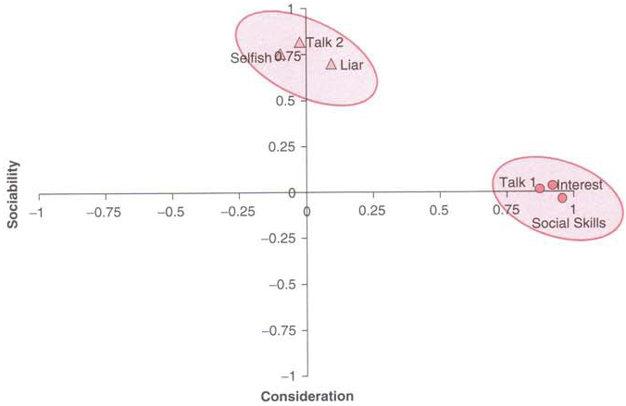
Factor plot
Data Analysis
Lecture 5
Factor Analysis

Slide 25
Explaining the factor plot (1)
Data Analysis
Lecture 5
Factor Analysis
We have two factors. For both factors the axis line ranges from -1 to 1, which are the outer limits of a correlation coefficient. Therefore, the position of a given variable depends on its correlation to the two factors.
The circles represent the three variables that correlate highly with factor 1 (sociability: horizontal axis), but have a low correlation with factor 2 (consideration to others: vertical axis). Conversely, the triangles represent variables that correlate highly with consideration to others, but have a low correlation to sociability.

Slide 26
Explaining the factor plot (2)
Data Analysis
Lecture 5
Factor Analysis
The co-ordinates of a variable represent its relationship to the factors. In an ideal world a variable should have a large co-ordinate for one of the axes, and low co-ordinates for any other factors. This scenario would indicate that this particular variable related to only one factor. Variables that have large co-ordinates on the same axis are assumed to measure different aspects of some common underlying dimension.

Slide 27
Factor loading
Data Analysis
Lecture 5
Factor Analysis
The co-ordinate of a variable along a classification axis is known as a factor loading. The factor loading can be thought of as the Pearson correlation between a factor and a variable. The squared factor loading is a measure of the substantive importance of a particular variable to a factor.
The factor loading tells us about the relative contribution that a variable makes to factor.

Slide 28
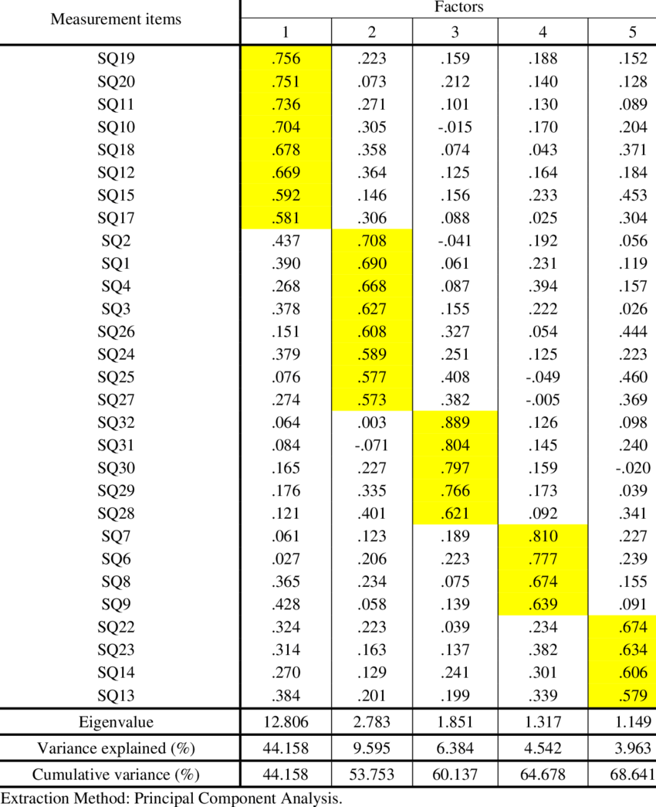
Factor loading matrix
Data Analysis
Lecture 5
Factor Analysis

Slide 29
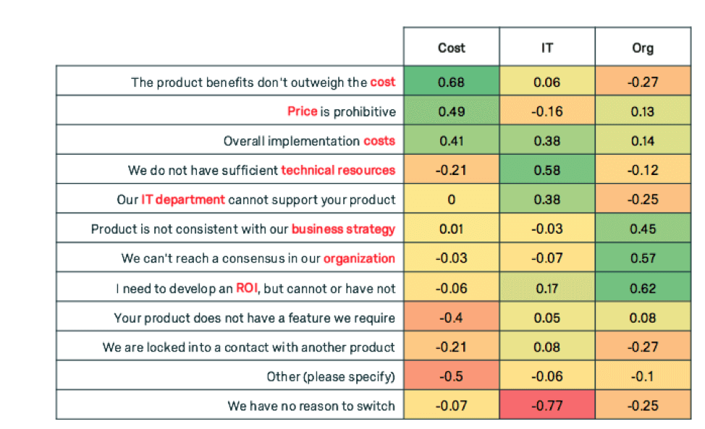
Data Analysis
Lecture 5
Factor Analysis

Slide 30
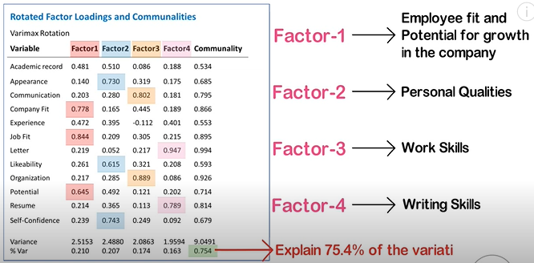
Data Analysis
Lecture 5
Factor Analysis

Slide 31
Factor equation
Data Analysis
Lecture 5
Factor Analysis
Factor_{i} = b₁*Variable₁ + b_{n}*Variable_{n} +E_{i}
b_{n} – factor loading
Sociability = 0,87*Talk1 + 0.96* Social Skills + 0,92* Interest + 0,00*Talk 2 + 0,10*Selfish + 0,09*Liar + E

Slide 32
Factor rotation
Data Analysis
Lecture 5
Factor Analysis
Factor rotation effectively rotates the factor axes such that variables are loaded maximally to only one factor.
Rotation may be:
orthogonal (factors are uncorrelated with one another) or
oblique (factors are allowed to correlate).
The choice of rotation is both empirically and theoretically driven.

Slide 33
Method of orthogonal rotation: varimax
Data Analysis
Lecture 5
Factor Analysis
Varimax attempts to maximize the dispersion of loadings within factors. Therefore, it tries to load a smaller number of variables highly onto each factor resulting in more interpretable clusters of factors.

Slide 34
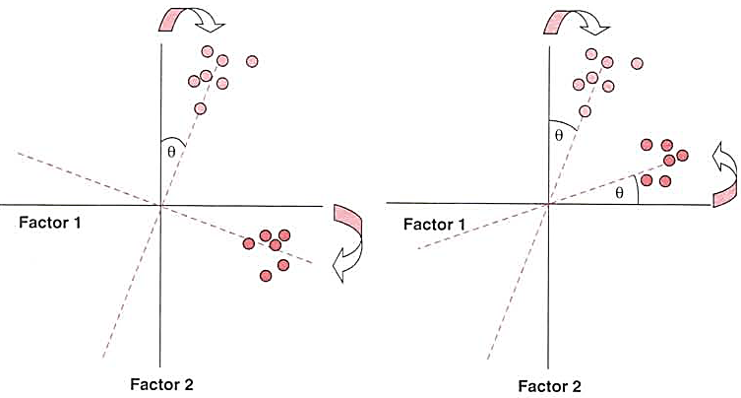
Factor rotation
Data Analysis
Lecture 5
Factor Analysis
Orthogonal rotation
Oblique rotation

Slide 35
Measure of sampling adequacy
Data Analysis
Lecture 5
Factor Analysis
The Kaiser-Meyer-Olkin Measure of Sampling Adequacy is a measure of the proportion of variance among variables that might be common variance.
The value of the indicator varies from 0 (factor analysis is likely to be inappropriate) to 1 (factor analysis should yield distinct and reliable factors).
The coefficient is calculated for a preliminary check of the feasibility of factor analysis. If the value of the coefficient is low, we can try to change the composition of the variables or eliminate outliers to increase it.

Slide 36
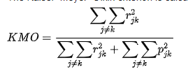
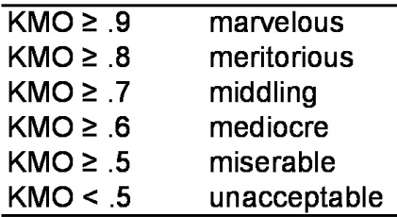
KMO
Data Analysis
Lecture 5
Factor Analysis
Where r_{jk} is a pairwise correlation between variables, p_{jk} is a partial correlation. A value close to 0 indicates that the sum of the partial correlations is large compared to the sum of the pairwise correlations, indicating that correlations do not cluster across multiple variables, which is a problem for factor analysis. On the contrary, a value close to 1 indicates the suitability of the data for factor analysis.

Slide 37
Difficulties in conducting factor analysis
Data Analysis
Lecture 5
Factor Analysis
Rational interpretation of the semantic meaning of each factor in relation to the goals and peculiarities of the research.
Impossibility of unambiguous classification of individual variables. A variable can be equally strongly correlated with several factor.
There is a partial loss of information during the "compression" of the initial array of variables.

Slide 38
Useful links
Data Analysis
Lecture 5
Factor Analysis
https://buildmedia.readthedocs.org/media/pdf/factor-analyzer/latest/factor-analyzer.pdf
https://www.datacamp.com/community/tutorials/introduction-factor-analysis
https://devopedia.org/principal-component-analysis

Slide 39
Thank you for your attention!
Faculty of Computer Science
Data Analysis
Moscow 2022

